Slide 1
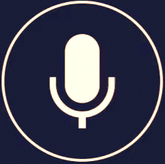
IVA-INTELLIGENT VOICE ASSISTANT
SUBMITTED TO:
Dr. ABHILASHA SHARMA
PROFESSOR ASSISTANT(SG)
SUBMITTED BY:
PRACHI VARSHNEY-211288
ISHA- 211293
CS-36

Slide 2
INTRODUCTION
Voice Assistant is a virtual assistant that uses speech recognition, natural language processing and speech synthesis to take actions on user utterances to help its users. Voice Assistants have become synonymous with Google Home and Amazon Echo. Underlying technology powering both these smart speakers are the actual voice assistants, Google Assistant and Amazon Alexa, respectively.‍ Today voice assistants are not limited to smart speakers but are also available in cars, household devices, smartphones, and several apps. So on our level we have tried our best to create the same using python language.

Slide 3
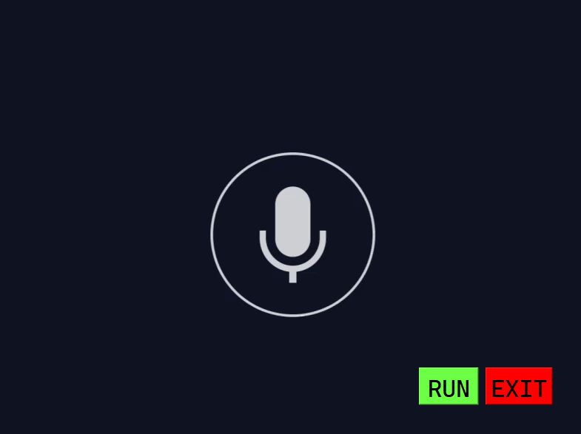
GUI OF OUR VOICE ASSISTANT

Slide 4
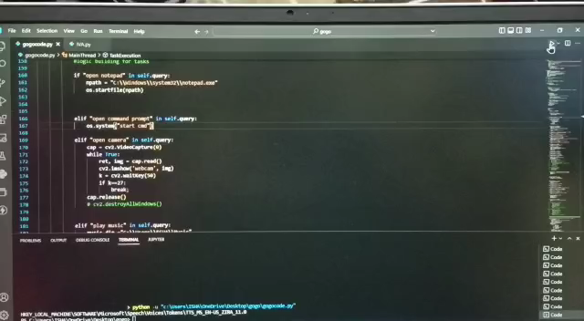
WORKING…

Slide 5
MAJOR FEATURES
GREETS YOU AS YOU RUN IT.
CAN TELL LATEST 10 NEWS.
CAN SEARCH QUERIES ON WIKIPEDIA.
CAN PLAY MUSIC.
HELP US WITH OUR CALCULATIONS.
IT CAN SEND EMAIL TO WHOEVER WE WANT.
IT CAN OPEN ANY APPLICATIONS PRESENT IN SYSTEM .
CAN CLOSE THE APPLICATION WHEN ORDERED TO DO SO.
ENTERTAIN US WITH ITS JOKES.
CAN READ PDF FOR OUR CONVINIENCE.
CAN SHUTDOWN / SLEEP / RESTART THE SYSTEM.
CAN TAKE SCREENSHOTS FOR US AND SAVE IT TOO.
CAN HAVE A CASUAL CONVERSATION

Slide 6

LIBRARIES USED:
import pyttsx3
import speech_recognition
import wikipedia
import webbrowser
import random
import sys
import time
import os
import os.path
Import cv2
Import requests

Slide 7
CONTINUED…
import pywhatkit as kit
import smtplib
import pyjokes
import pyautogui
import PyPDF2
from email.mime.text import MIMEText
from email.mime.multipart import MIMEMultipart
from email.mime.base import MIMEBase
from email import encoders
import instaloader
import operator #for calculation using voice
Import pyQT5

Slide 8
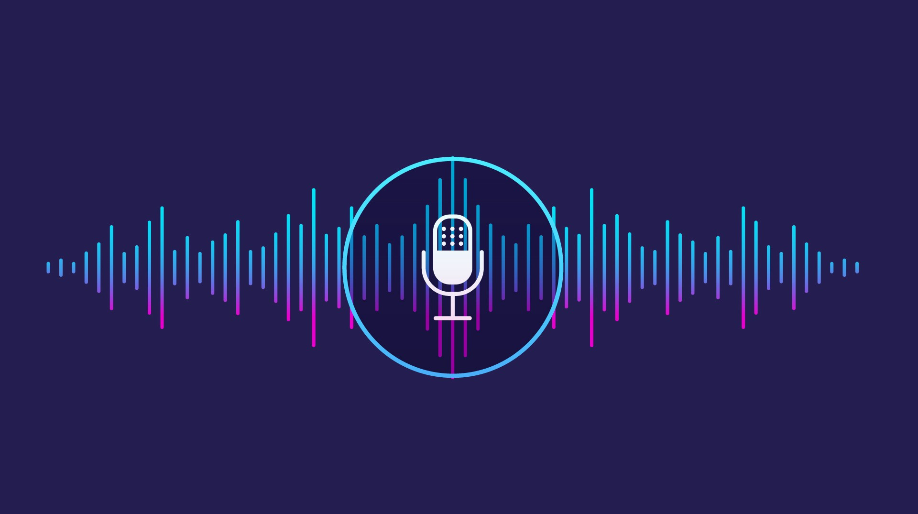
FUTURE PLANS
PERSONALIZED EXPERIENCES
INBUILT SECURITY FEATURES FOR USERS
VOICE ASSISTANT IN MOBILE APPS

Slide 9
Thank you
ANY QUESTIONS ?

